Slide 1
Comparison of TV Show Scoring Sites
Alex Li
Webscraping Project

Slide 2
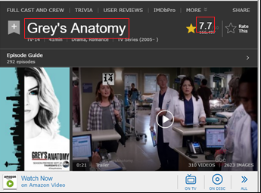

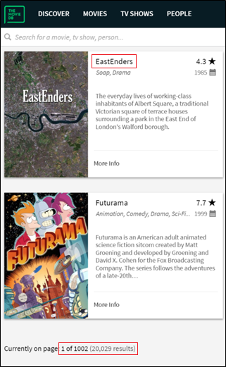
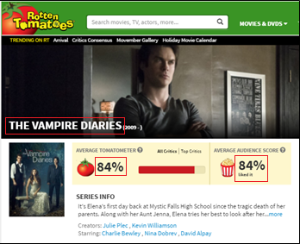
Data Source

Slide 3
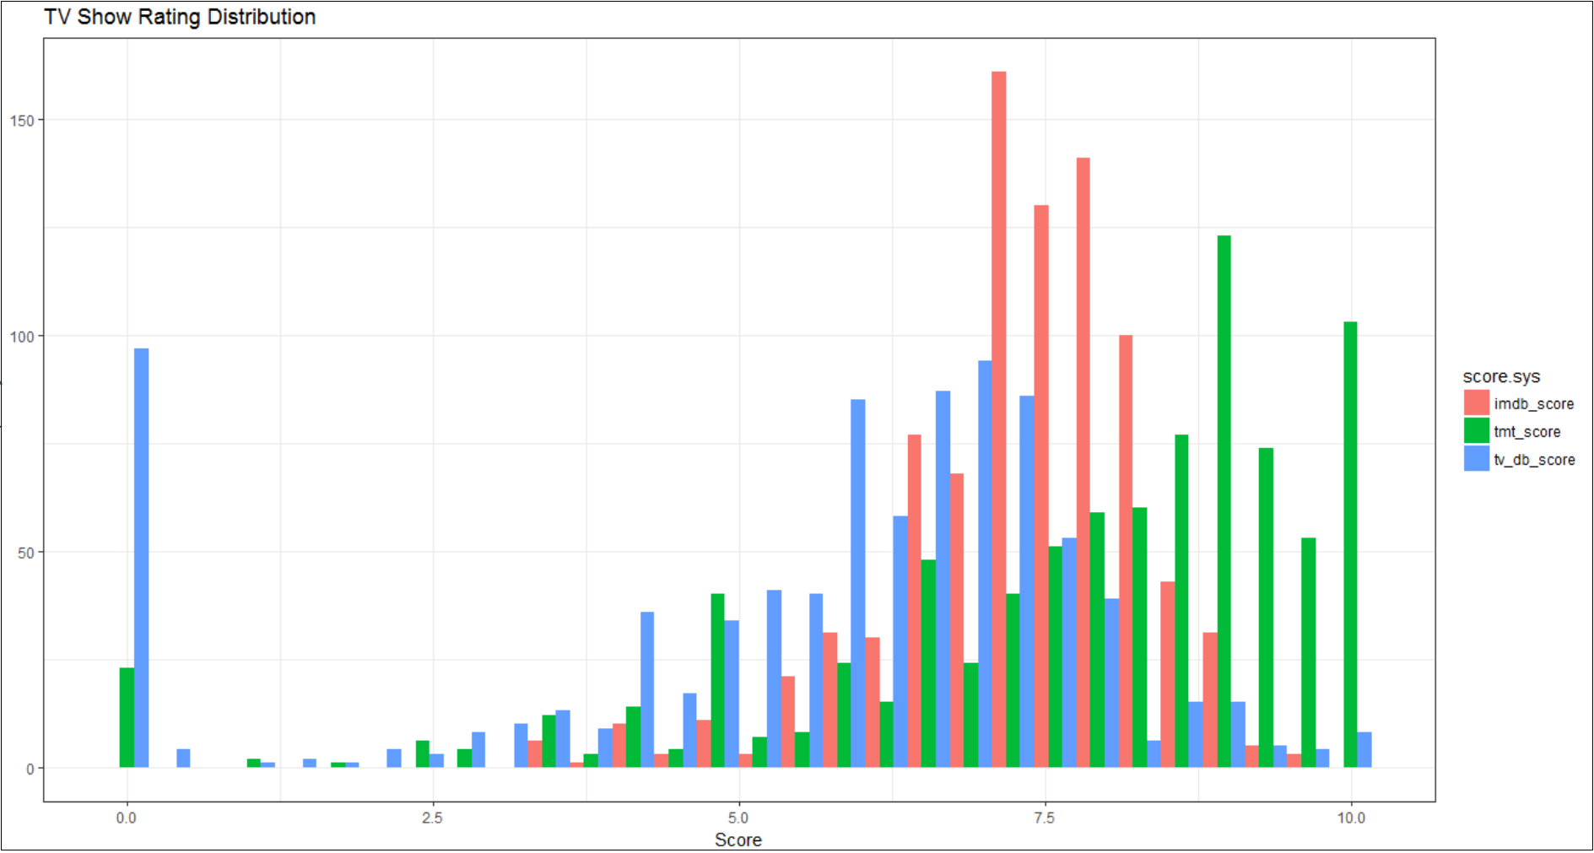
Exploratory Visualization

Slide 4
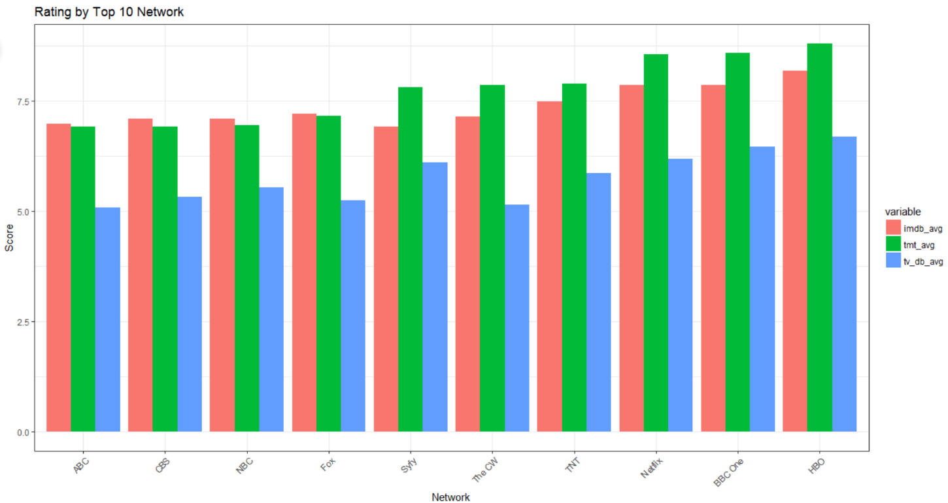
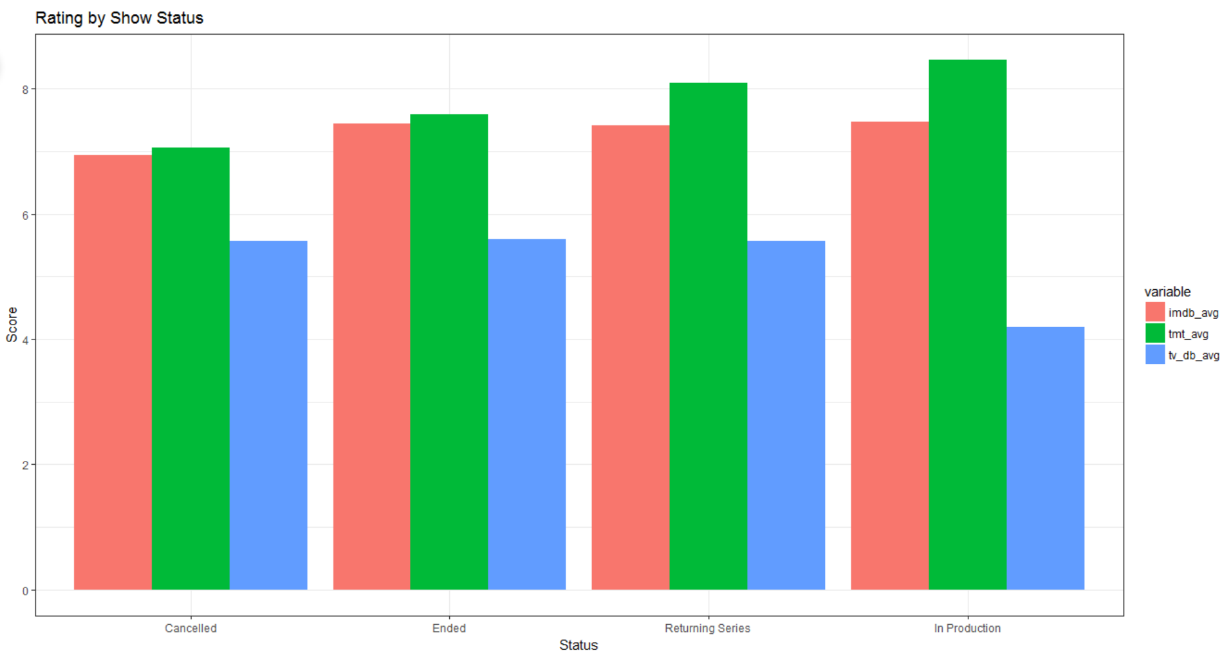
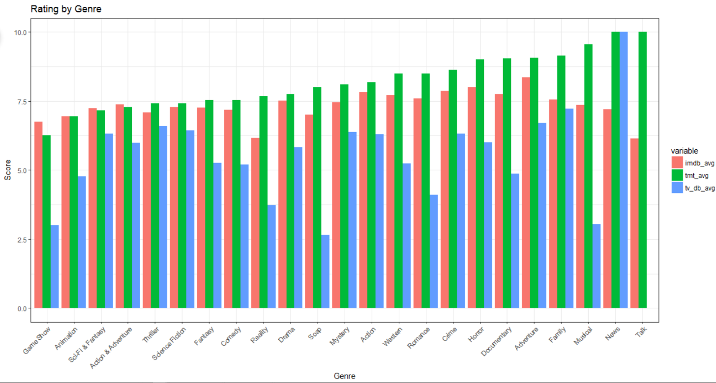
HBO network has the highest average score than the rest in all three sites.
Cancelled and Ended TV Series has lower score compared to Returning Series.
In Production Serise have the highest score…interesting…

Slide 5
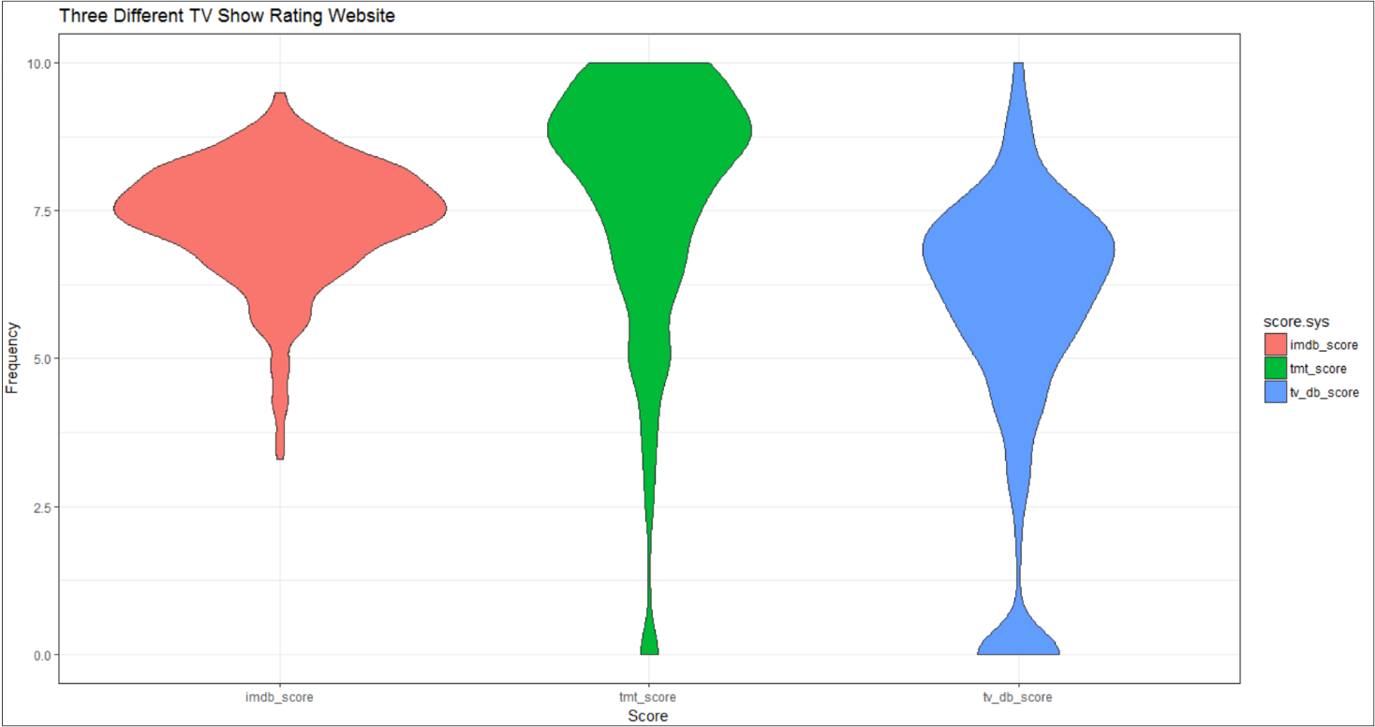
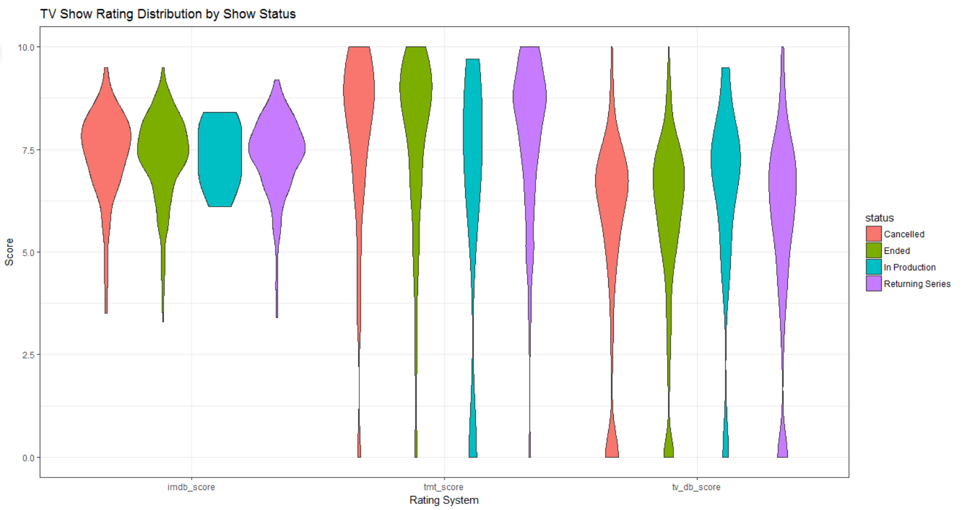
Rotten Tomato has the highest mean and distribution, followed by IMDb, and TVDb has the lowest.
TVDb score has a lot of zero scores, Rotten Tomato has fewer zero scores, and IMDb has no zero scores.
The show status distribution within each website doesn’t deviate much.
The distributions for In Production Series exhibit peculiar shapes, probably due to smaller sample size.

Slide 6
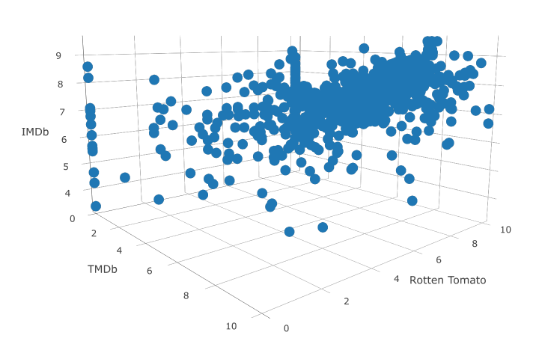

Slide 7
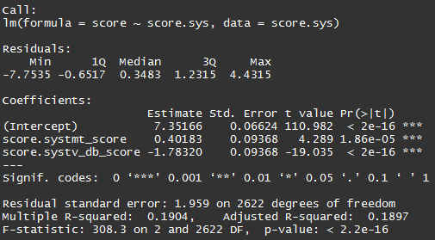
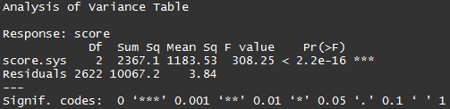
Linear Regression Model
Small p-values for the coefficients indicate statistical significance between each rating system.
One way ANOVA also confirms significance
One-Way ANOVA

Slide 8
Insights
The statistical test show that the three websites scores differently.
The Rotten Tomato scores are tend to be higher than IMDb and TVDb.

